Slide 1
SOIL PROPERTIES PREDICTION BY
USING MACHINE LEARNING
BY
Jasmin Babariya
(202319001)
Darshan Gajera
(202319006)
Harsh Chothani
(202319010)
Deep Pethani
(202319011)
Smit Bhuva
(202319027)
SUBMITTED TO
Dr. Ranendu Ghosh
Dr. Viral Dave

Slide 2
OBJECTIVES
To create a smart computer program using machine learning that can tell us about the nutrients in the soil by using SCROPAN model. This will help farmers know how to take care of their land better for growing crops.
To empower farmers to make decisions for sustainable crop production and soil management, we will leverage machine learning to enhance soil nutrient prediction.
To significantly impact agriculture and related industries, the project focuses on accurately predicting soil nutrient levels. This provides valuable insights for advancing agricultural practices and ultimately boosting crop productivity.

Slide 3
WHAT IS SCORPAN MODEL ?
The SCORPAN model is a widely used framework in digital soil mapping that combines various spatial and environmental factors to predict soil properties.
The SCORPAN model has been shown to be an effective tool for DSM. It has been used to map a wide variety of soil properties, including soil pH, and soil organic carbon and soil nutrients
The model is typically implemented using statistical methods, such as regression or kriging.

Slide 4
SCORPAN MODEL
The SCORPAN model is an empirical model used in digital soil mapping (DSM).
It includes seven factors:
S = Soil - Existing soil properties and characteristics
C = Climate - Prevailing climatic conditions, including temperature, precipitation and humidity
O = Organisms - Vegetation, land cover, and biological activity in the soil
R = Relief - Topographic features, including elevation, slope
P = Parent Material - The underlying geological material from which soil is derived
A = Age - The time period over which soil formation has occurred
N = Space - Geographic location and spatial distribution of soil properties

Slide 5
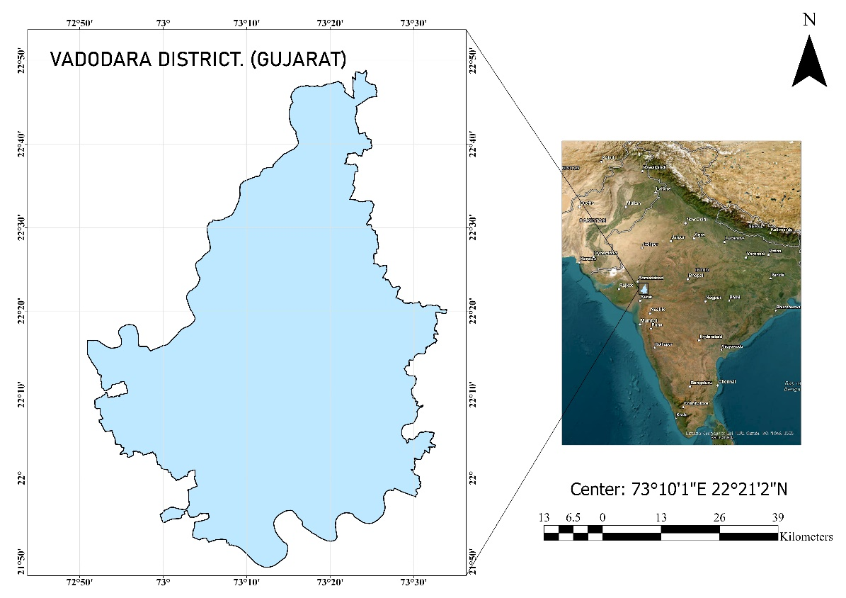
STUDY AREA

Slide 6
DATASETS
1. NDVI
https://developers.google.com/earth-engine/datasets/catalog/LANDSAT_LC08_C01_T1_32DAY_NDVI
2. DEM
https://developers.google.com/earth-engine/datasets/catalog/USGS_SRTMGL1_003
3. LST
https://developers.google.com/earth-engine/datasets/catalog/LANDSAT_LC08_C01_T1_8DAY_TOA#terms-of-use
4. Data CSV File by AAU
5. Vadodara SHP file

Slide 7
FLOWCHART
Download Images
By using GEE
Map Generation
Machine Learning
Algorithm
(Linear Regression)
Normalized Images
Sample Raster
Stack
Images
Data CSV

Slide 8
VADODARA DISTRICT SHP FILE
Import Indian Village Boundary SHP File
Dissolve Tool
Tool Box
Write Query & Get Vadodara dis. Polygon
Export SHP file
Dissolve Boundary by the District

Slide 9
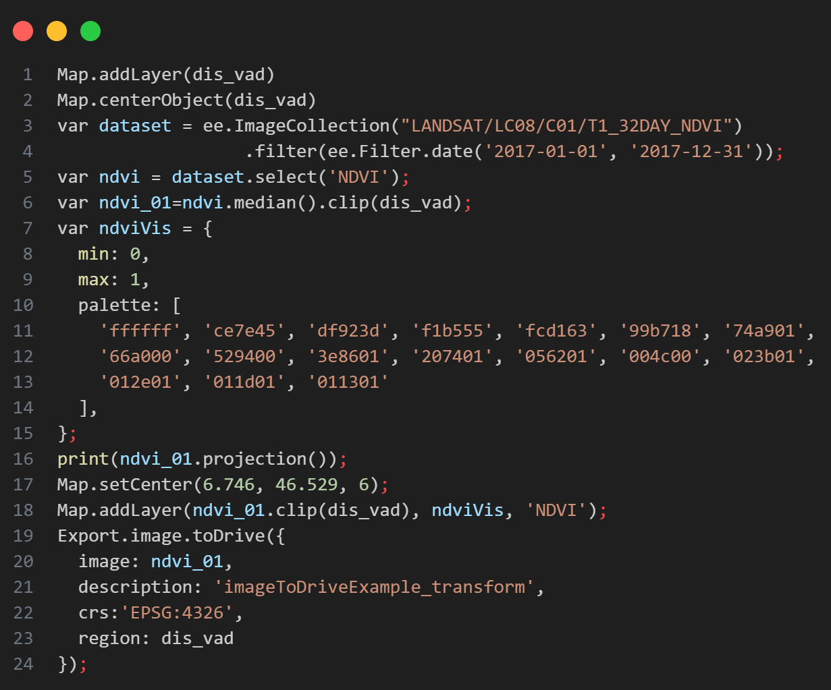
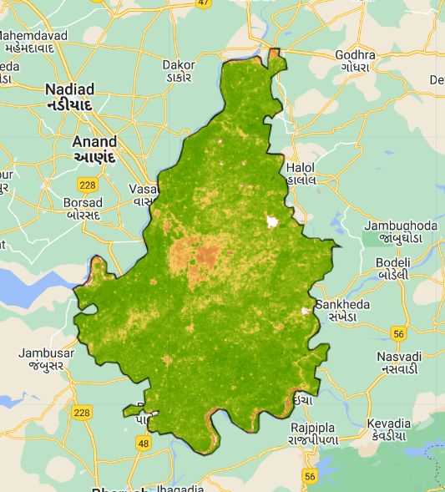
CODE SNIPPET & OUTPUT

Slide 10
GENERATE A SAMPLE POINT FROM CSV
Import Sample Data CSV
Display XY
Data Tool
Generate the Sample Points by Lat. , Lon.
Export Sample Points SHP file

Slide 11
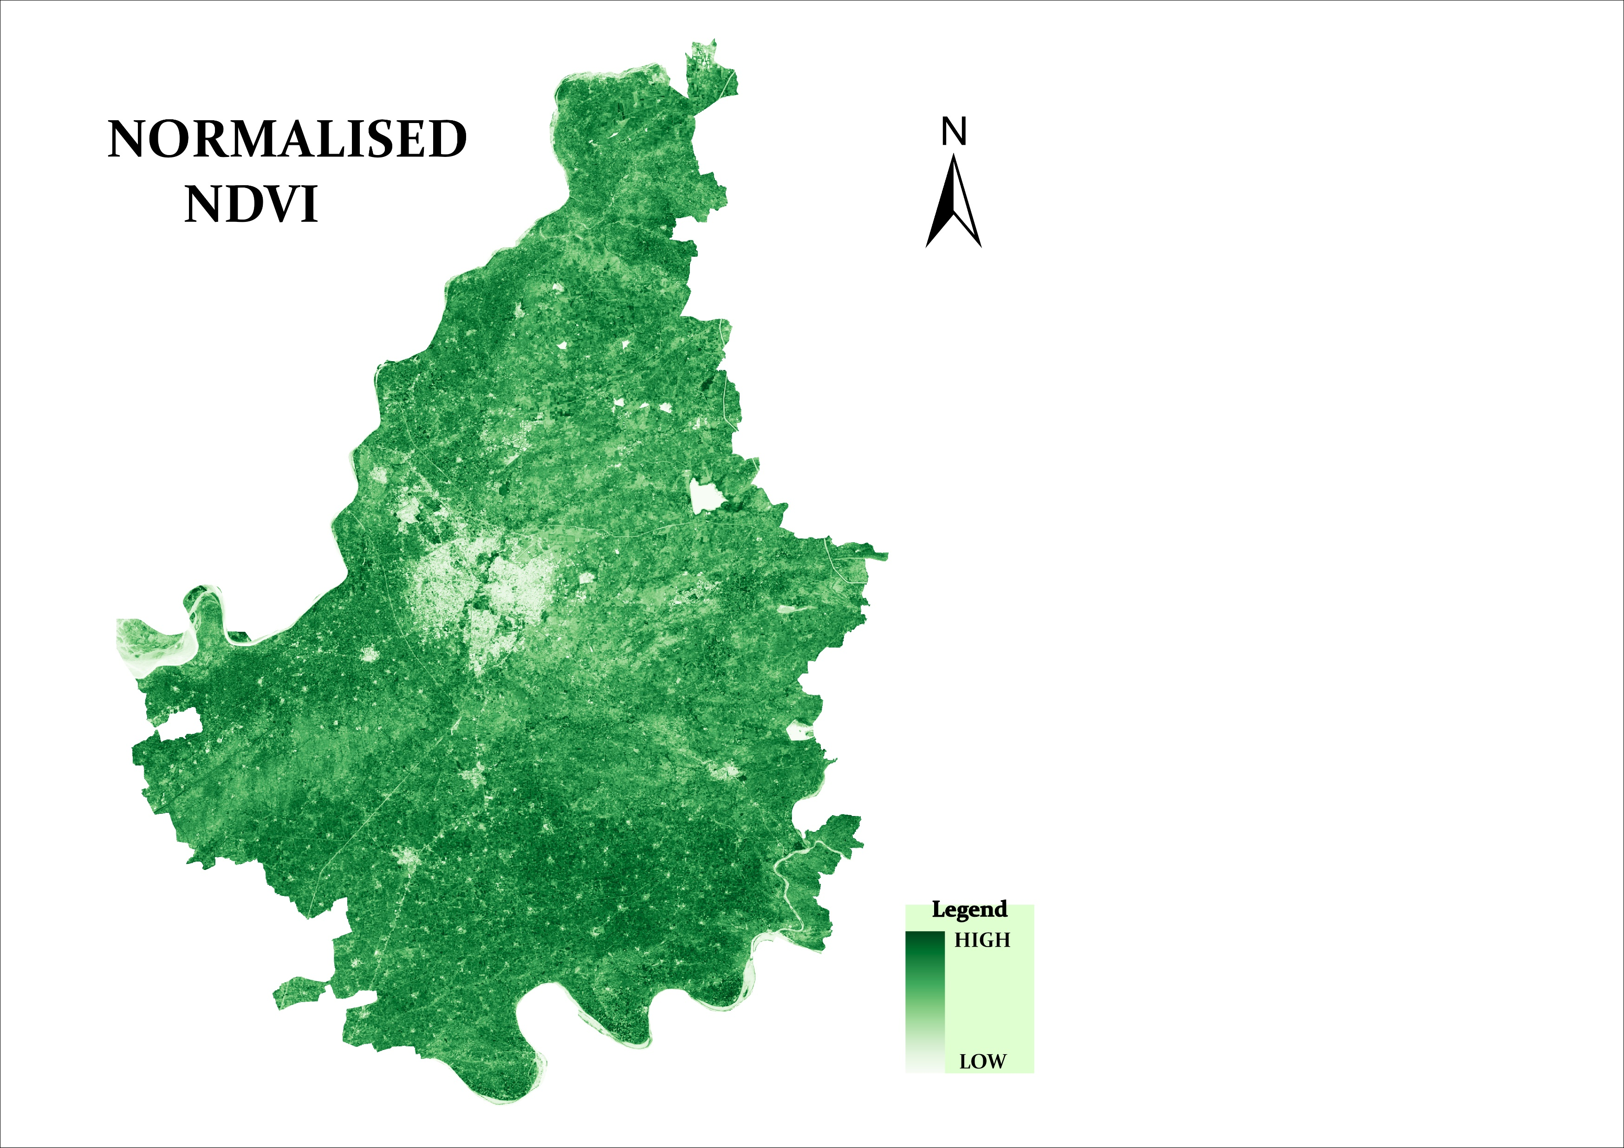
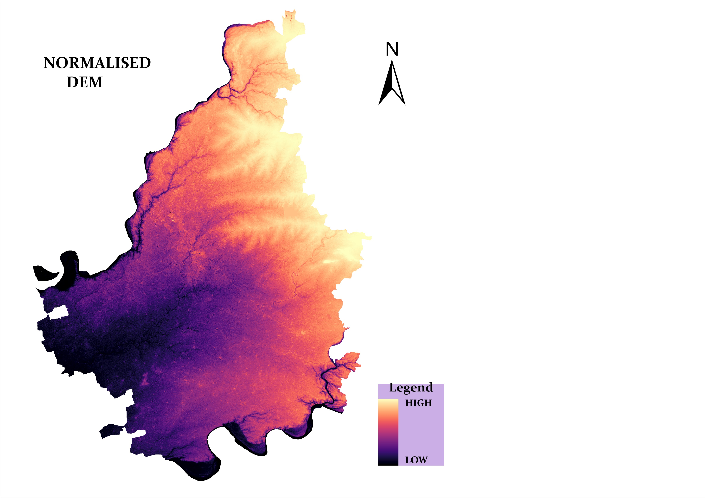
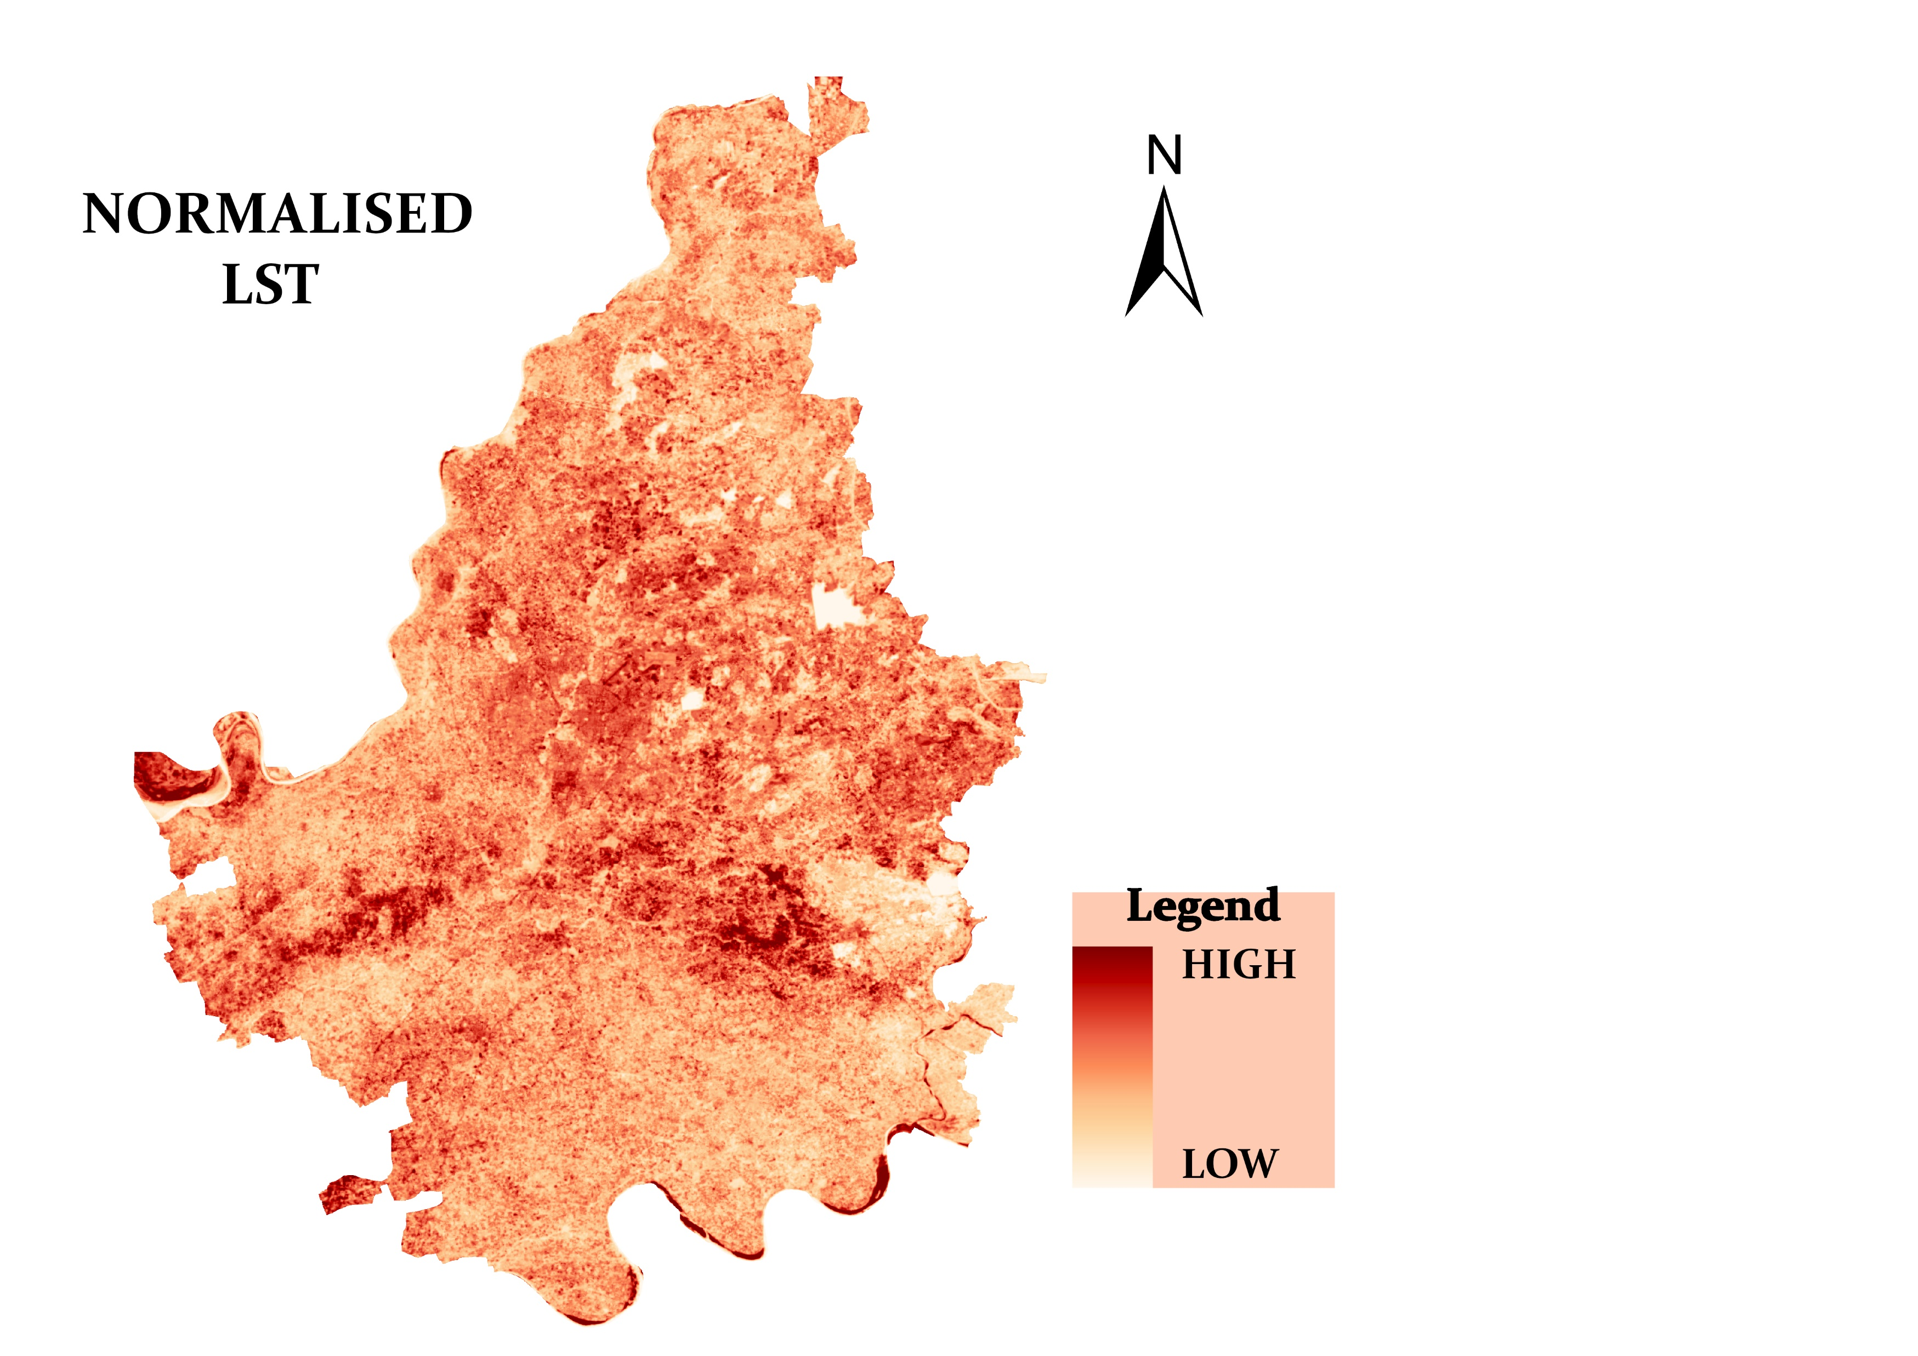
NORMALIZED IMAGES
Normalize NDVI, DEM, and LST GeoTIFF files using the raster calculator tool in QGIS.
Formula: (Raster Value - Raster Minimum) / (Raster Maximum - Raster Minimum).

Slide 12
SAMPLE RASTER DATA
Load normalized NDVI, DEM, and LST raster images into QGIS.
Import sample point coordinates (X, Y) into QGIS.
Extract raster values for each sample point using the "Sample Raster Values" tool.
Generate sampled points for each variable (NDVI, DEM, LST).
Add new columns to the sample point layer for NDVI, DEM, and LST.
Populate these columns with the sampled values.

Slide 13
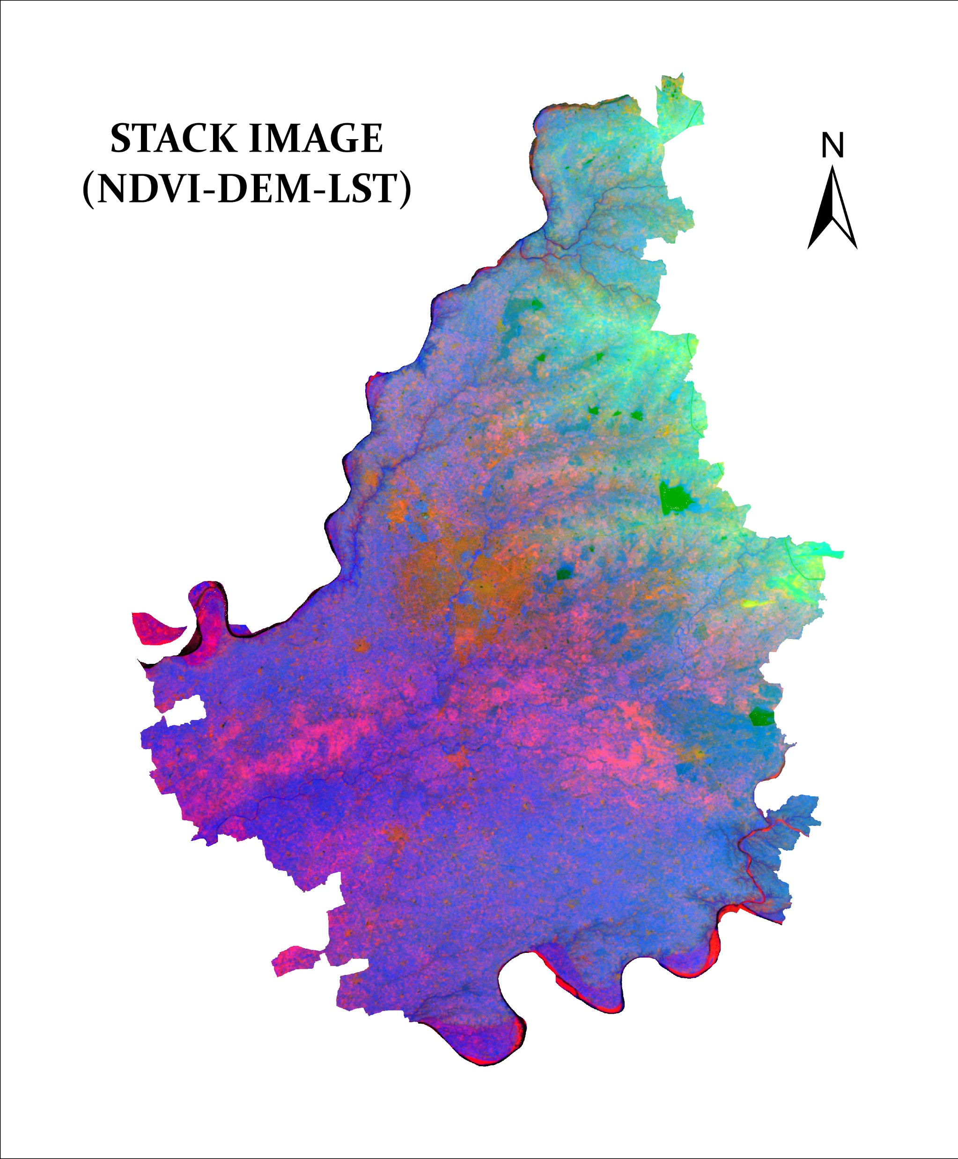
STACK IMAGE
Import normalized NDVI, DEM, and LST raster images into ERDAS Imagine.
Then go to Spectral tool and then go to Stack Layers.
Use the "Stack Layers" tool in ERDAS Imagine to combine the raster images into a single multiband image.
Specify the output file name, location, and TIFF file order.
Save the stacked image in TIFF format.

Slide 14
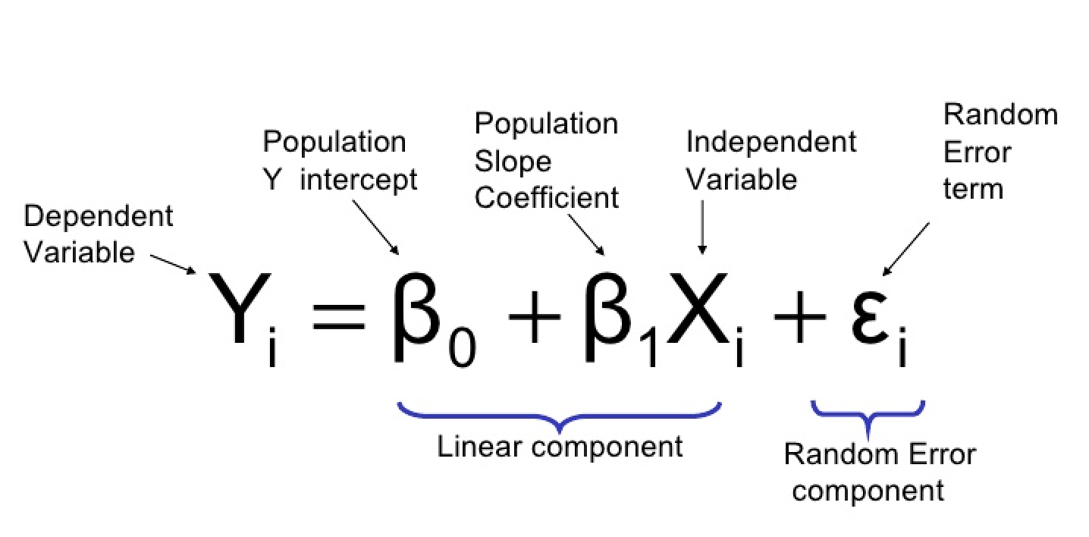
MACHINE LEARNING
Data Collection
Model Processing
Model Selection
Export TIFF file
Generate Raster Images
Model Training
MAE and RMSE are the measure differences between predicted and actual values.

Slide 15
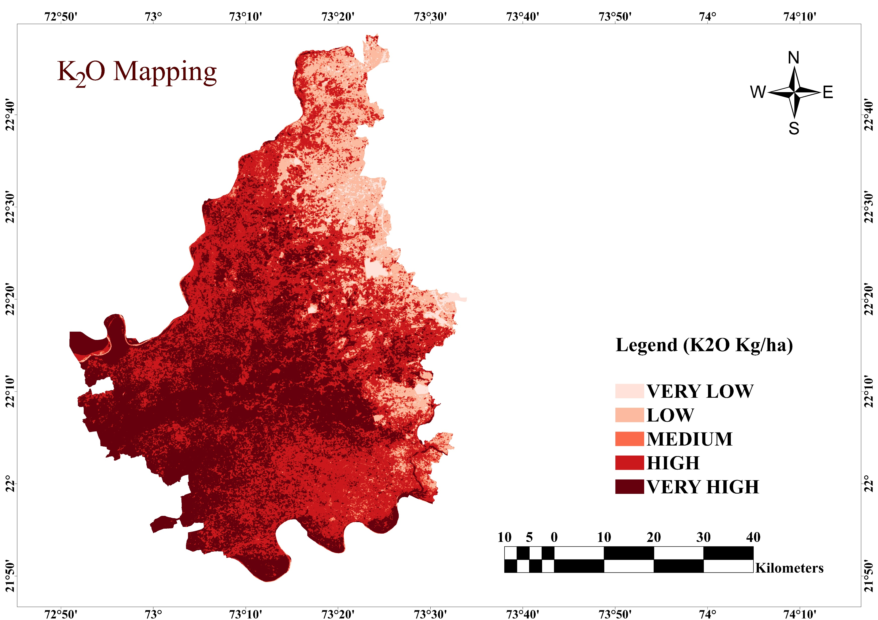

POTASSIUM MAPPING
K Level | Village
87.7-329.6 | Ranipura
 | Tulsigam
 | Udalpur
400.6-457.9 | Nada
 | Borbar
87.7-329.6
329.6-387.02
387.02-400.6
400.6-457.9
400.6-457.9

Slide 16
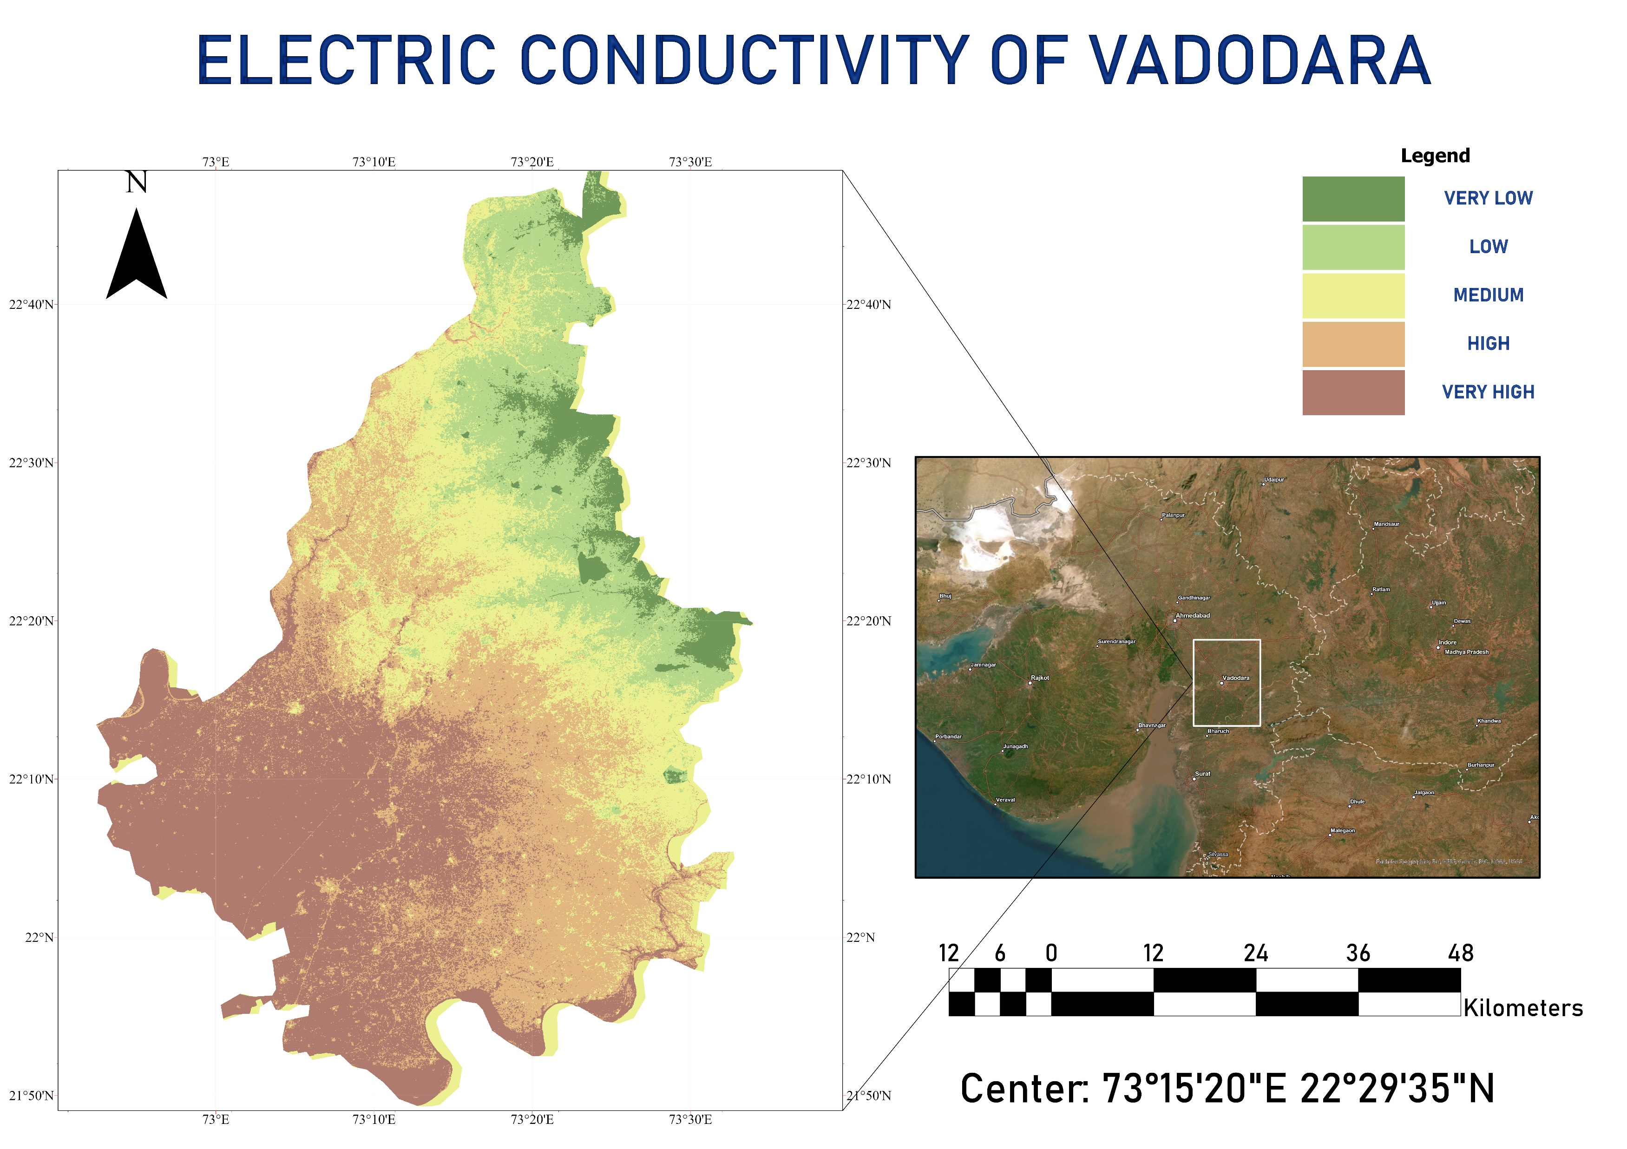

EC MAPPING
0.0-0.703
0.70-0.76
0.76-0.80
EC Level (dS/m) | Village
0.0-0.703 | Tulsipura
 | Gambhipur
 | Vejpur
0.83-1.5 | Pura
 | Urad
0.80-0.83
0.83-1.5

Slide 17
CONCLUSION
We used linear regression to make simple maps that help us understand how soil nutrients are spread out in our study area.
Our project found direct connections between scorpan factors and how much nutrients are in the soil, giving us useful insights for better managing our farming resources.
We figured out that how fertile the soil is. This helps us make smart choices for taking care of the land in a way that keeps it healthy and sustainable.
Maps predict nutrient changes, aiding resource planning in agriculture.
Linear regression improves soil nutrient predictions, enhancing agricultural precision.

Slide 18
REFERENCES
Khosravani, P., Baghernejad, M., Moosavi, A. A., & FallahShamsi, S. R. (2023). Digital mapping to extrapolate the selected soil fertility attributes in calcareous soils of a semiarid region in Iran. Journal of Soils and Sediments, 1-23.
Wu, Z., Chen, Y., Zhu, Y., Feng, X., Ou, J., Li, G., ... & Yan, Q. (2023). Mapping Soil Organic Carbon in Floodplain Farmland: Implications of Effective Range of Environmental Variables. Land, 12(6), 1198.
https://buildmedia.readthedocs.org/media/pdf/rasterio/latest/rasterio.pdf

Slide 19
THANK YOU

